Slide 1
Classify Tennis Shot Outcome
Amith and Arun

Slide 2
Problem Statement
Given a dataset of tennis matches predict the outcome of a future shot as winner, forced error or unforced error
Initial thoughts on the problem: Tennis shots end with either of the above mentioned 3 outcomes. Using the attributes of each shot like speed, rallies, distance from the baseline and sideline try to predict the outcome of the future shots.

Slide 3
EDA
There are 26 features and 8001 observations
There are no missing values in the dataset
There are 7 categorical variables and rest are numerical variables
ID column is redundant

Slide 4
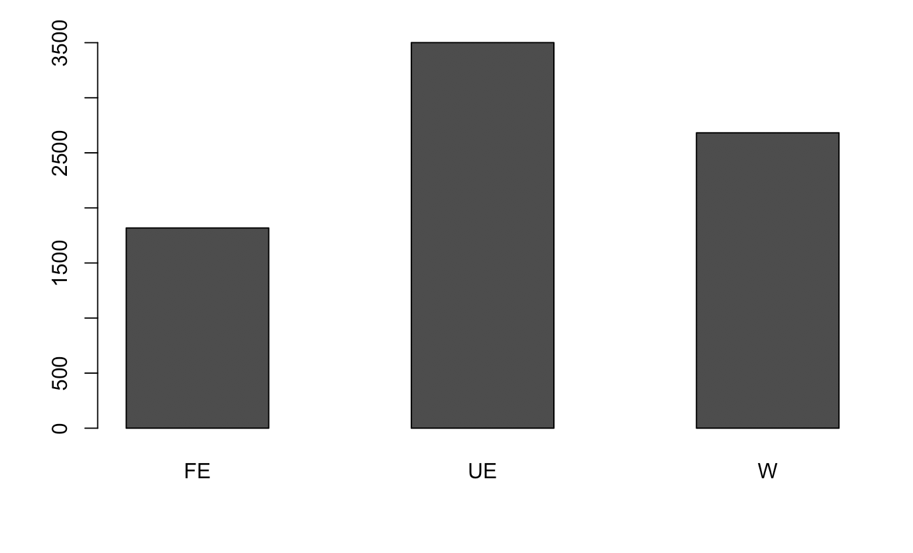
EDA(Contd), Distribution of Outcome in Dataset
Outcome has 3 classes and the data is distributed without much of class imbalance

Slide 5
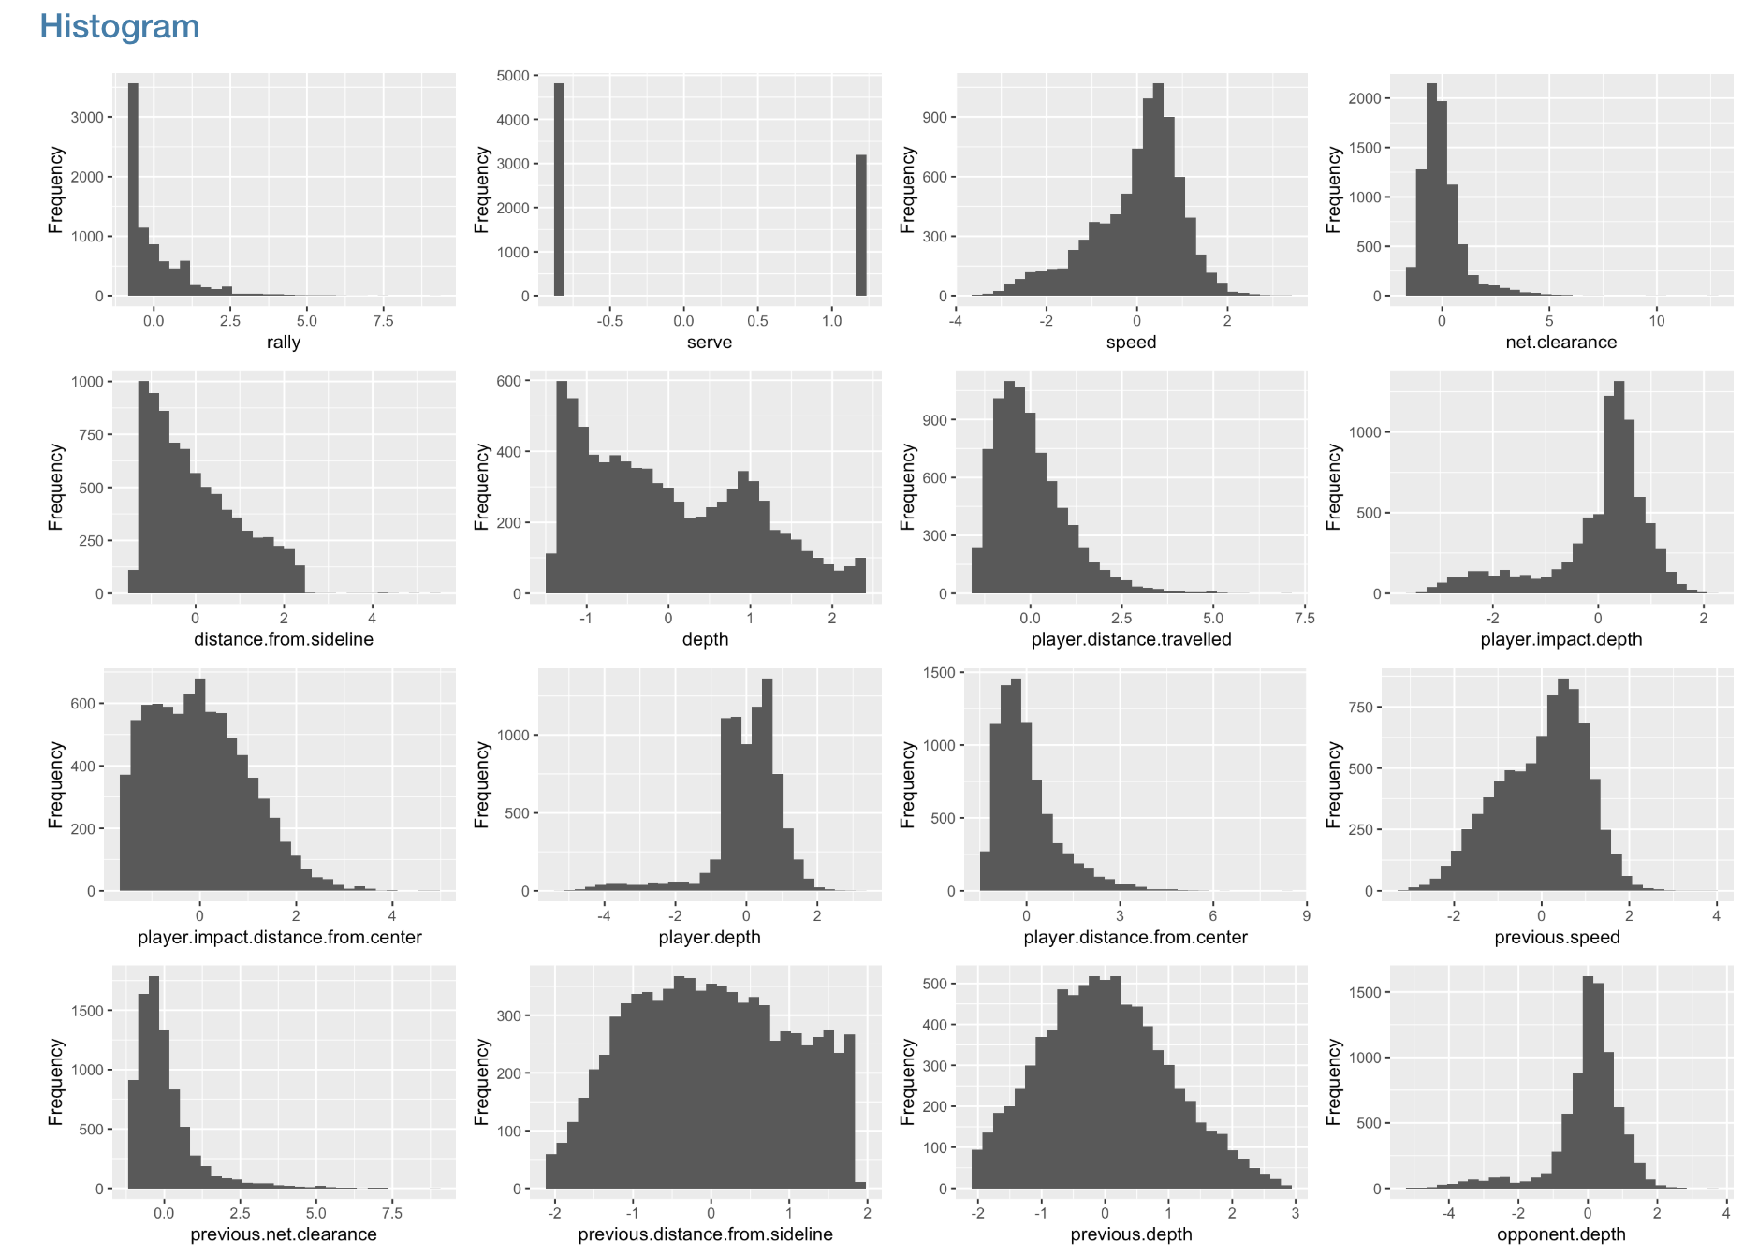
EDA(contd)

Slide 6
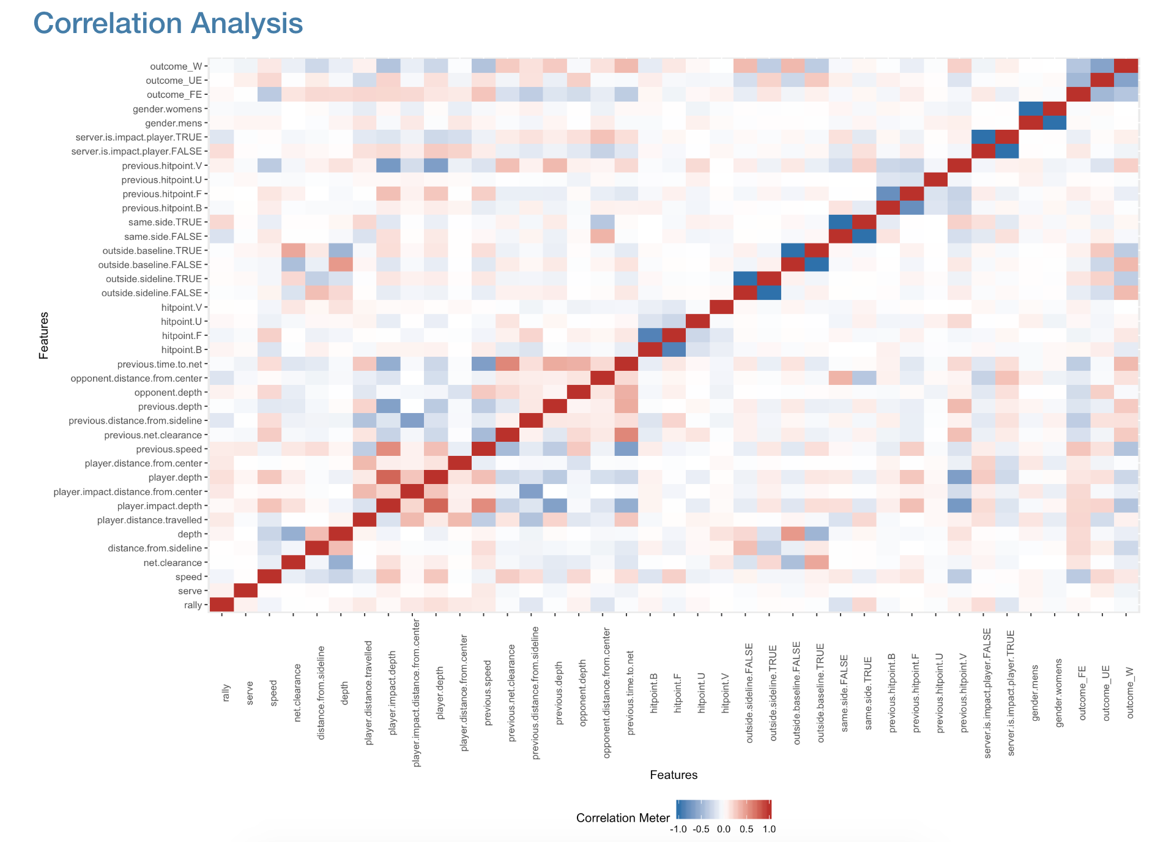
EDA(contd)

Slide 7
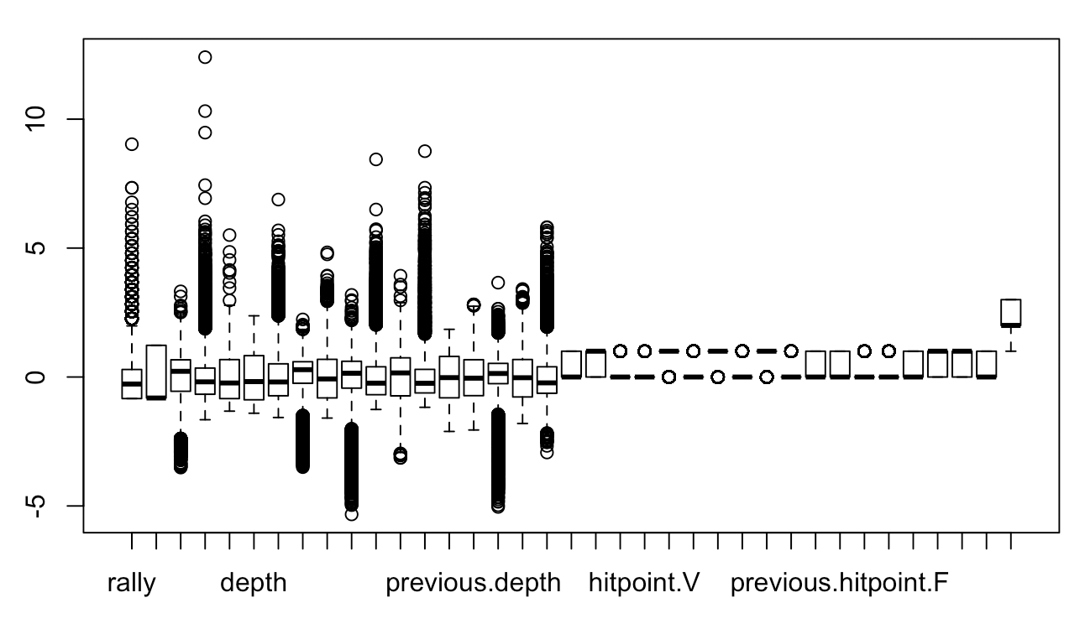
Outlier Detection

Slide 8
Preprocessing
Numerical data is separated and scaled
Categorical data is dummified
Have tried PCA (but did not improve the accuracy)

Slide 9
Model Building and Prediction
Using K fold cross validation with a k value of 5/3 with repeats set to 2 / 3
Have tried build multiple models for classification
Naive Bayes
Logistic Regression
KNN - with different values of K
SVM
Decision Trees
Random Forest
Gradient Boost
XGBoost

Slide 10
Ensembling
Have ensembled models with boosting and stacking
Boosting
Gradient Boost
XGBoost
Stacking
Level1: RF + XGB + Log Reg + KNN
Level2: GBM

Slide 11
Hyperparameter tuning
We tuned the hyper parameters of multiple models
Random Forest - mtry, ntree
KNN - K
XGBoost - gamma, nrounds, max depth
Tried various values to come up with optimal parameters

Slide 12
Optimization and Accuracy
Since its a classification problem confusion matrix with accuracy as the measure was used
We achieved a max accuracy of 87.59 on test data on a stacked model
A simpler model with just random forest was giving an accuracy of 87.54

Slide 13
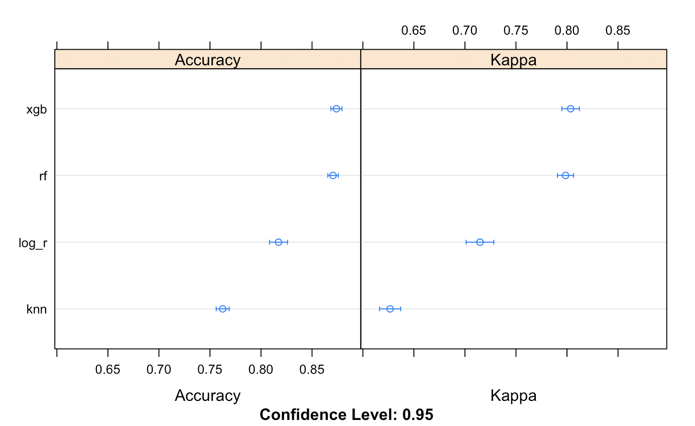
Comparison of Model Accuracy

Slide 14
Conclusion
Random Forest gave the best prediction individually
Stacking improved the accuracy marginally
XGBoost was giving almost a similar accuracy as that of Random Forest
Random Forest was overfitting the train data

